Slide 1
What is Service Mesh?
2019/4/4 Istio Service Mesh Introduction
127.0.0.1:5500/#54 5/58
1 / 58

Slide 2
Service Mesh?
2019/4/4
Istio Service Mesh Introduction
Describe the network of microservices that make up applications and the interactions between them
Service Discovery Load Balancing Failure Recovery Metrics and Monitoring
2 / 57/588

Slide 3
Service Mesh?
2019/4/4
Istio Service Mesh Introduction
More complex operational requirements
A/B Testing Canary Rollouts Rate Limiting Access Control
End-to-end Authentication
8 / 58/588

Slide 4

Istio
2019/4/4
Istio Service Mesh Introduction
Open source independent service mesh
Deployed as sidecars in the Pods CNCF hosted project(Envoy)
150/588

Slide 5
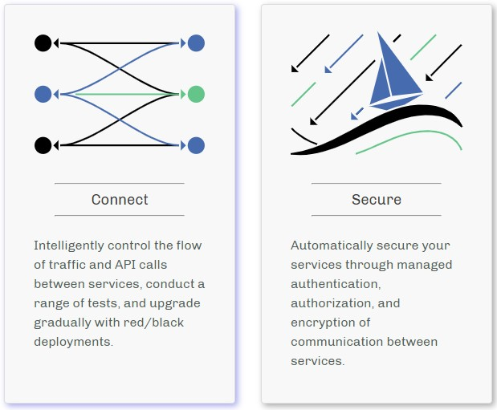
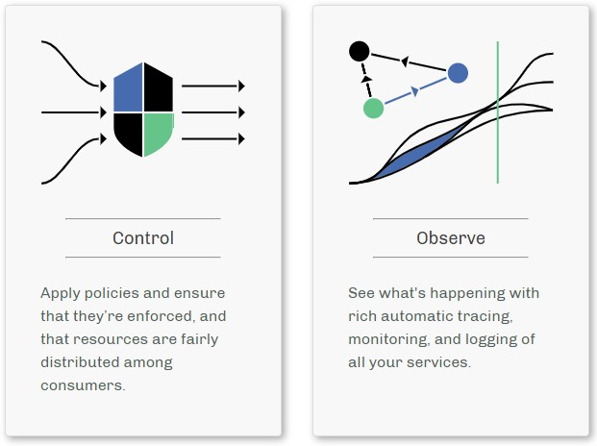
2019/4/4
Istio
Istio Service Mesh Introduction
Connect, secure, control, and observe services
151/588

Slide 6

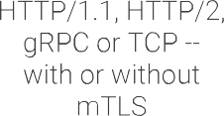

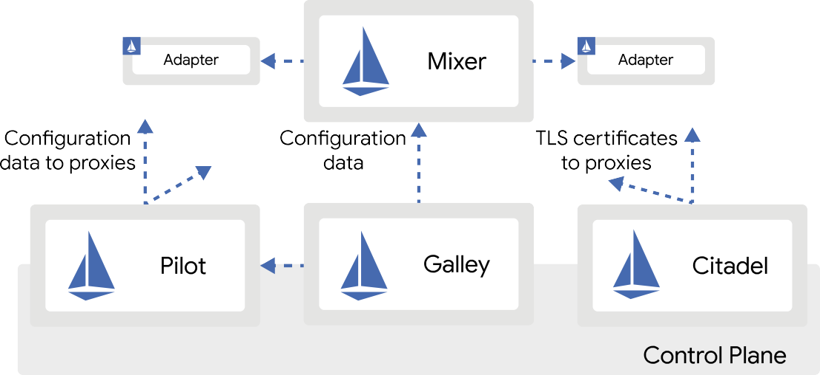
Architecture
2019/4/4
Istio Service Mesh Introduction
152/588

Slide 7
Architecture
2019/4/4
Istio Service Mesh Introduction
Data plane
Envoy Control plane
Mixer Pilot Citadel Galley
153/588

Slide 8

Envoy
2019/4/4
Istio Service Mesh Introduction
A high-performance proxy developed in C++
Deployed as a sidecar in the Kubernetes Pod
Add to an existing deployment with no need to rearchitect or rewrite code
154/588

Slide 9
Envoy
2019/4/4
Istio Service Mesh Introduction
Features
Dynamic Service Discovery Load Balancing
TLS Termination
HTTP/2 and gRPC proxies
155/588

Slide 10
Envoy
2019/4/4
Istio Service Mesh Introduction
Circuit Breakers
Health Checks
Staged Rollouts with %-based Traffic Split Fault Injection
Rich Metrics
156/588

Slide 11
Mixer
2019/4/4
Istio Service Mesh Introduction
Responsible for providing policy controls and telemetry collection
Enforces access control and usage policies across the service mesh
Collects telemetry data from the Envoy proxy and other services
Includes a flexible plugin model
157/588

Slide 12























Mixer
2019/4/4
Istio Service Mesh Introduction
158/588

Slide 13
Pilot
2019/4/4
Istio Service Mesh Introduction
Provides service discovery for:
Envoy sidecars
Traffic management capabilities for intelligent routing (e.g. A/B Tests, Canary Rollouts)
Resiliency
(e.g. Timeouts, Retries, Circuit Breakers)
159/588

Slide 14
















Pilot
2019/4/4
Istio Service Mesh Introduction
159/588

Slide 15
Citadel
2019/4/4
Istio Service Mesh Introduction
Strong service-to-service/end-user authentication with built-in identity and credential management
Galley
Istio’s configuration validation, ingestion, processing and distribution component
159/588

Slide 16
Setup using Istio on GKE
2019/4/4 Istio Service Mesh Introduction
127.0.0.1:5500/#54 22/58
16 / 58

Slide 17
Set IAM
2019/4/4
Istio Service Mesh Introduction
Set the default compute service account to include:
roles/container.admin (Kubernetes Engine Admin) Editor (on by default)
253/588

Slide 18
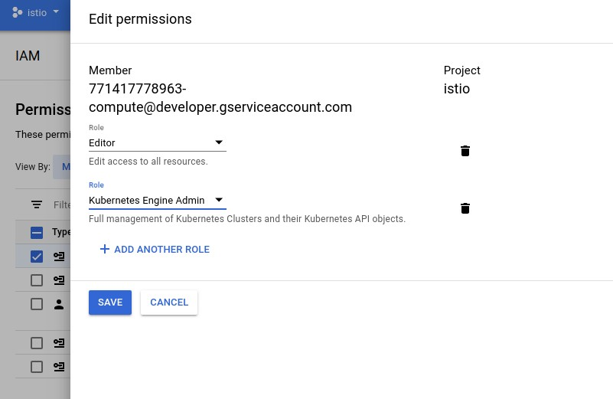
Set IAM
2019/4/4
Istio Service Mesh Introduction
254/588

Slide 19
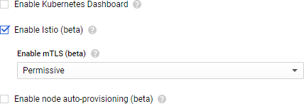
Create a Cluster
2019/4/4
Istio Service Mesh Introduction
Need 4 nodes
Check "Enable Istio (beta)" on Advanced options
255/588

Slide 20
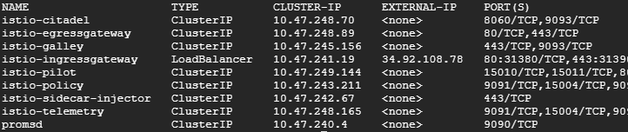
Istio Resources
2019/4/4
Istio Service Mesh Introduction
$ kubectl get svc -n istio-system
or
$ kubectl get po -n istio-system
256/588

Slide 21
Install Istio
2019/4/4
Istio Service Mesh Introduction
Go to the Istio release page to download the installation file
Extract the downloaded installation file
Change directory to the root of the Istio installation
Add the istioctl client to the PATH:
$ export PATH=$PWD/bin:$PATH
257/588

Slide 22
Sample Application
2019/4/4
Istio Service Mesh Introduction
258/588

Slide 23





Bookinfo
2019/4/4
Istio Service Mesh Introduction
Reviews-v1
Requests
Reviews-v2
Product page
Ratings
Reviews-v3
Ruby
Details
259/588

Slide 24
Bookinfo
2019/4/4
Istio Service Mesh Introduction
4 separate microservices:
Productpage Details Reviews Ratings
259/588

Slide 25
Bookinfo
2019/4/4
Istio Service Mesh Introduction
3 versions of the Reviews microservice:
Version v1
doesn’t call the ratings service
Version v2
calls the ratings service, and displays black stars
Version v3
calls the ratings service, and displays red stars
259/588

Slide 26
Deploy
2019/4/4
Istio Service Mesh Introduction
Enable automatic sidecar injection:
$ kubectl label namespace default \ istio-injection=enabled
Deploy the application using kubectl:
$ kubectl apply -f \ samples/bookinfo/platform/kube/bookinfo.yaml
259/588

Slide 27
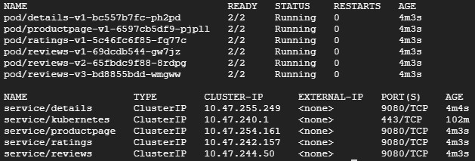
Resources
2019/4/4
Istio Service Mesh Introduction
Confirm all services and pods are running:
$ kubectl get po,svc
259/588

Slide 28
Define Ingress Gateway
2019/4/4
Istio Service Mesh Introduction
$ kubectl apply -f \ samples/bookinfo/networking/bookinfo-gateway.yaml
$ kubectl get gateway NAME AGE
bookinfo-gateway 17s
259/588

Slide 29
Control Ingress Traffic
2019/4/4
Istio Service Mesh Introduction
259/588

Slide 30
Httpbin
2019/4/4
Istio Service Mesh Introduction
HTTP testing service that can be used for experimenting with all kinds of Istio features
$ kubectl apply -f samples/httpbin/httpbin.yaml
259/588

Slide 31
Set variables
2019/4/4
Istio Service Mesh Introduction
Set the ingress IP and ports:
$ export INGRESS_HOST=$(kubectl -n istio-system get service istio-ingressgateway \
-o jsonpath='{.status.loadBalancer.ingress[0].ip}')
$ export INGRESS_PORT=$(kubectl -n istio-system get service istio-ingressgateway \
-o jsonpath='{.spec.ports[?(@.name=="http2")].port}')
$ export SECURE_INGRESS_PORT=$(kubectl -n istio-system get service \
istio-ingressgateway -o jsonpath='{.spec.ports[?(@.name=="https")].port}')
259/588

Slide 32
Create an Istio Gateway
2019/4/4
Istio Service Mesh Introduction
kubectl apply -f - <<EOF
apiVersion: networking.istio.io/v1alpha3 kind: Gateway
metadata:
name: httpbin-gateway spec:
selector:
istio: ingressgateway # use Istio default gateway implementation servers:
- port:
number: 80 name: http protocol: HTTP
hosts:
- "*"
EOF
259/588

Slide 33
Configure routes
2019/4/4
Istio Service Mesh Introduction
kubectl apply -f - <<EOF
apiVersion: networking.istio.io/v1alpha3 kind: VirtualService
metadata: name: httpbin
spec:
hosts:
- "*"
gateways:
httpbin-gateway http:
match:
uri:
prefix: /headers route:
destination: port:
number: 8000 host: httpbin
EOF
259/588

Slide 34
Virtual Service
2019/4/4
Istio Service Mesh Introduction
Contains the route rules that Allows traffic for path
/headers
All other external requests will be rejected
$ export GATEWAY_URL=$INGRESS_HOST:$INGRESS_PORT
$ $ curl -I http://$GATEWAY_URL/headers HTTP/1.1 200 OK
...
$ $ curl -I http://$GATEWAY_URL/status HTTP/1.1 404 Not Found
...
259/588

Slide 35
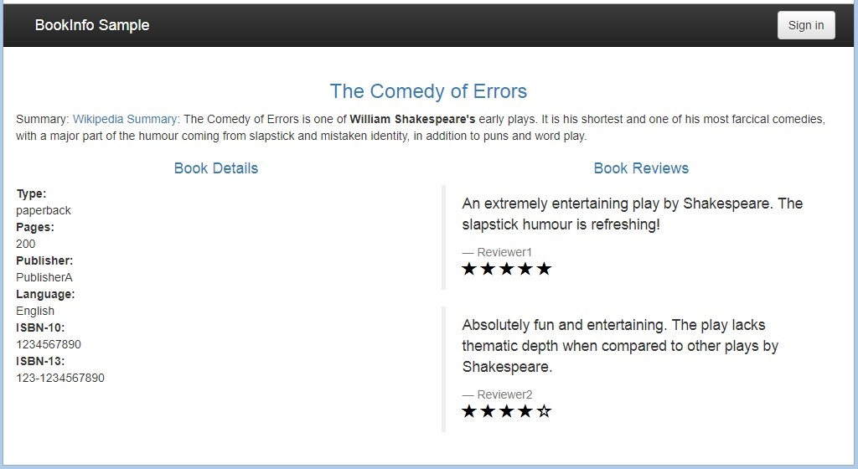
Bookinfo Web Page
2019/4/4
Istio Service Mesh Introduction
http://$GATEWAY_URL/productpage
259/588

Slide 36
Bookinfo Web Page
2019/4/4
Istio Service Mesh Introduction
If you refresh the page several times, you should see different versions of reviews shown in productpage, presented in a round robin style
red stars black stars no stars
since we haven’t yet used Istio to control the version routing.
259/588

Slide 37
Apply default destination rules
2019/4/4
Istio Service Mesh Introduction
Create default destination rules for the Bookinfo services:
$ kubectl apply -f \ samples/bookinfo/networking/destination-rule-all.yaml
Display the destination rules:
$ kubectl get destinationrules -o yaml
259/588

Slide 38
Traffic Management
2019/4/4 Istio Service Mesh Introduction
127.0.0.1:5500/#54 44/58
38 / 58

Slide 39
Request routing
2019/4/4
Istio Service Mesh Introduction
Introduces the concept of a service version:
Versions (v1, v2) Environment (staging, prod)
Choose service version dynamically based on the routing rules that specified by using Pilot
455/588

Slide 40



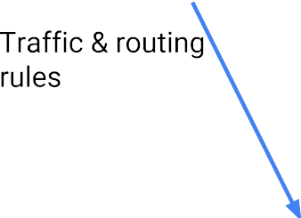













Request routing
2019/4/4
Istio Service Mesh Introduction
456/588

Slide 41
Request routing
2019/4/4
Istio Service Mesh Introduction
Route to v1:
$ kubectl apply -f \
samples/bookinfo/networking/virtual-service-all-v1.yaml
Display the defined routes:
$ kubectl get virtualservices -o yaml
457/588

Slide 42
Discovery and load balancing
2019/4/4
Istio Service Mesh Introduction
HTTP traffic is automatically re-routed through Envoy
3 load balancing modes: Round robin
Random
Weighted least request
Checks the health of each instance
458/588

Slide 43








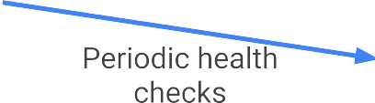
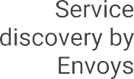
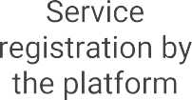




Discovery and load balancing
2019/4/4
Istio Service Mesh Introduction
459/588

Slide 44
Discovery and load balancing
2019/4/4
Istio Service Mesh Introduction
Apply weight-based routing:
Transfer 50% of the traffic from reviews:v1 to reviews:v3
$ kubectl apply -f \
samples/bookinfo/networking/virtual-service-reviews-50-v3.yaml
Route based on user identity:
$ kubectl apply -f \
samples/bookinfo/networking/virtual-service-reviews-test-v2.yaml
459/588

Slide 45
Handling failures
2019/4/4
Istio Service Mesh Introduction
Timeouts
Bounded retries with timeout budgets and variable jitter between retries
Limits on number of concurrent connections and requests to upstream services
Active (periodic) health checks on each member of the load balancing pool
Fine-grained circuit breakers (passive health checks)
459/588

Slide 46
Fault injection
2019/4/4
Istio Service Mesh Introduction
Test the end-to-end failure recovery capability
Protocol-specific fault injection into the network instead of deleting pods/ delaying/ corrupting packets
2 types of faults
Delays: Timing failures (Increased network latency/ Overloaded upstream service)
Aborts: Crash failures (HTTP error codes/ TCP connection failures)
459/588

Slide 47
Canary rollout
2019/4/4
Istio Service Mesh Introduction
Introduce a new version of a service by first testing it using a small percentage of user traffic.
Kubernetes provides features that support canary rollout: Uses instance scaling to manage the traffic distribution
Only supports a simple (random percentage) canary rollout
459/588

Slide 48
Canary rollout
2019/4/4
Istio Service Mesh Introduction
With Istio:
The number of pods are orthogonal to the control of version traffic routing
Control fine grain traffic percentages
(e.g. route 1% of traffic without requiring 100 pods)
Control traffic using other criteria (e.g. route traffic for specific users)
459/588

Slide 49
Links
2019/4/4
Istio Service Mesh Introduction
Microservice Architecture https://microservices.io/index.html
Istio.io https://istio.io/
Istio Solutions | Google Cloud https://cloud.google.com/istio/
459/588

Slide 50
Links
2019/4/4
Istio Service Mesh Introduction
Installing Istio on GKE https://cloud.google.com/istio/docs/istio-on-gke/installing
Install Istio on the Google Kubernetes Engine https://istio.io/docs/setup/kubernetes/install/platform/gke/
Bookinfo Application https://istio.io/docs/examples/bookinfo/
459/588

